Slide 1
Design and Analysis of Algorithms (CS345/CS345A)
Lecture 35
Pattern Matching

Slide 2

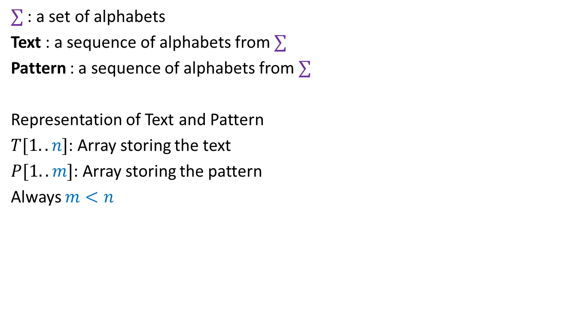

Problem Definition
$∑$ : a set of alphabets
Text : a sequence of alphabets from $∑$
Pattern : a sequence of alphabets from $∑$
Representation of Text and Pattern
$T[1..n]$: Array storing the text
$P[1..m]$: Array storing the pattern
Always $m<n$
$$T$$
a a b a c a a b a a a b a a b b c . . .
$$P$$
a a b a a
a a b a a
a a b a a

Slide 3









Problem Definition
$$1$$
$$i$$
$$n$$
Definition: Pattern matches Text at a location $i$ if
for $k=1$ to $m$, $P\left[k\right]=$ $T\left[ ? \right]$
Question: Find all occurrences of the pattern in the text.
$$T$$
$$P$$
$$1$$
$$m$$
$$i−m+k$$

Slide 4


First attempt
$$1$$
$$i$$
$$n$$
Definition: Pattern matches Text at a location $i$ if
for $k=1$ to $m$, $P\left[k\right]=$ $T\left[ ? \right]$
Question: Find all occurrences of the pattern in the text.
Observation: O($m$) time algorithm to check if $P$ occurs at $i$in $T$
Fact 1: This is also the best we can do for any given $i$.
O($mn$) time algorithm to find all occurrences of $P$ in $T$.
$$T$$
$$P$$
Does Fact 1 imply that we can’t achieve better than O($mn$) time ?
$$1$$
$$m$$
$$i−m+k$$
No.
The following slide will inspire you.

Slide 5

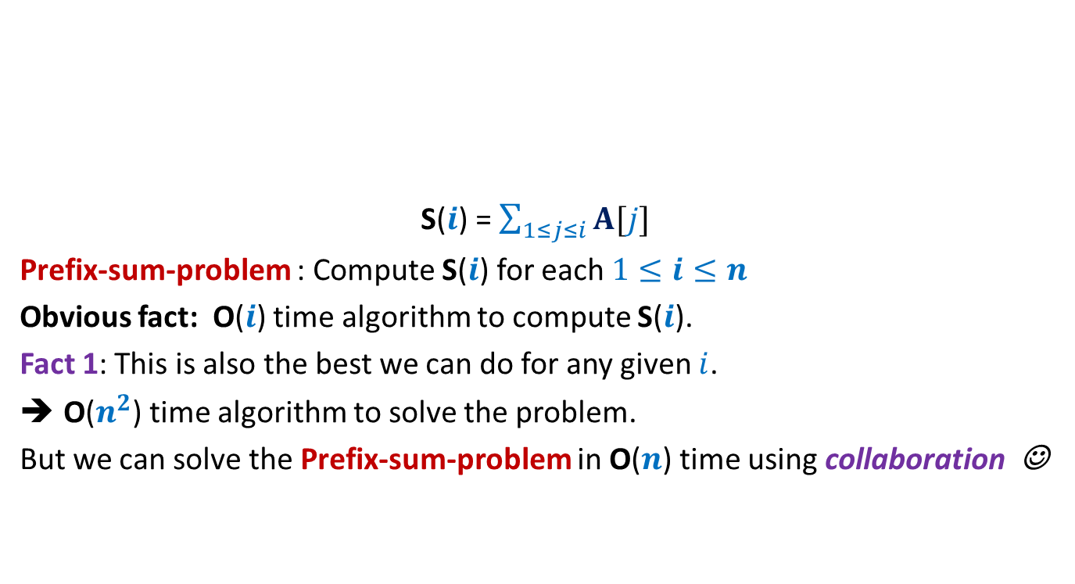
Prefix sum
$$i$$
S($i$) = $\sum_{1≤j≤i}{A[j]}$
Prefix-sum-problem : Compute S($i$) for each $1≤i≤n$
Obvious fact: O($i$) time algorithm to compute S($i$).
Fact 1: This is also the best we can do for any given $i$.
O($n^{2}$) time algorithm to solve the problem.
But we can solve the Prefix-sum-problem in O($n$) time using collaboration ☺
A
$$1$$ | $$5$$ | $$−3$$ | $$7$$ | $$9$$ | $$−8$$ | $$1$$ | $$3$$ | $$6$$ | $$−4$$ | $$8$$ | $$2$$
S($i$) = S($i−1$)+ A($i$)

Slide 6



Insight for collaboration
$$1$$
$$i$$
$$i+1$$
$$n$$
Instead of verifying matching at location $i+1$ from scratch,
we should exploit the partial-matching at location $i$
$$T$$
How to quantify the notion of partial-matching?

Slide 7






Pattern matching at a location $i$
$$1$$
$$i$$
$$n$$
$F(i)$: longest prefix of $P$ that is matched at location $i$.
$f(i)$ = Length of $F(i)$.
If $f\left(i\right)=m$, pattern matches at location $i$of text.
$$T$$
$$F\left(i\right)$$
$$P$$
$$1$$
$$m$$

Slide 8

Computing $f(i)$ Collaboratively
incrementally

Slide 9

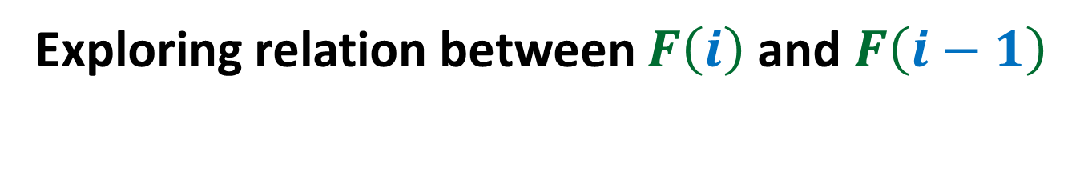



Exploring relation between $F\left(i\right)$ and $F\left(i−1\right)$
$$i$$
$$1$$
$$i−1$$
$$n$$
Observation: $f\left(i\right)$ $≤ f\left(i−1\right)+1$.
$$T$$
$$F\left(i−1\right)$$
$$F\left(i\right)$$
IMPOSSIBLE

Slide 10




Exploring relation between $F\left(i\right)$ and $F\left(i−1\right)$
$$i$$
$$1$$
$$i−1$$
$$n$$
Theorem:
A non-empty $F\left(i\right)$ is of the form $X∷T[i]$, where
$X$is a prefix of $F\left(i−1\right)$
$$T$$
$$F\left(i−1\right)$$
$$F\left(i\right)$$
$$X$$
How does a non-empty $F\left(i\right)$ look like ?
that is also a suffix of $F\left(i−1\right)$.

Slide 11

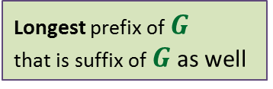
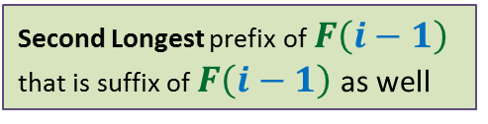


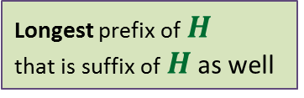
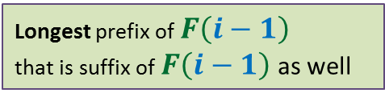

Computing $F\left(i\right)$ using $F\left(i−1\right)$
$$i$$
$$1$$
$$i−1$$
$$n$$
$$T$$
$$F\left(i−1\right)$$
?
?
?
Longest prefix of $F\left(i−1\right)$
that is suffix of $F\left(i−1\right)$ as well
Let it be $G$
Second Longest prefix of $F\left(i−1\right)$
that is suffix of $F\left(i−1\right)$ as well
Longest prefix of $G$
that is suffix of $G$ as well
Let it be $H$
Longest prefix of $H$
that is suffix of $H$ as well
$$X$$
Do you realize that we just need to preprocess the pattern suitably ?

Slide 12







The function $π$
$$1$$
$$k$$
$$m$$
$$P^{k}$$
$P^{k}$: $P[1..k]$
$π(k)$: The length of longest proper prefix of $P^{k}$ which is also a suffix of $P^{k}$
Observation: $π(k)$< $k$ always.
$$P$$

Slide 13

The function $π$
$π(1)$ = $0$
$π(2)$ = $0$
$π(3)$ = $1$
$π(4)$ = $2$
$π(5)$ = $3$
$π(6)$ = $4$
$π(7)$ = $0$
$π(8)$ = $1$
$$P$$
a | b | a | b | a | b | c | a

Slide 14

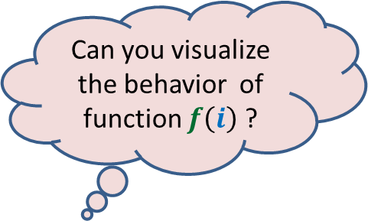
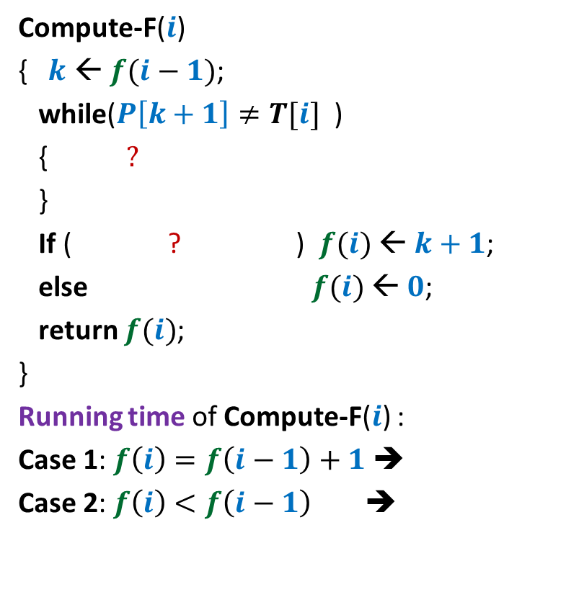








Computing $F\left(i\right)$
Compute-F($i$)
{ $k$ ← $f(i−1)$;
while($P\left[k+1\right]≠T[i]$ )
{ $?$
}
If ( ? ) $f(i)$ ← $k+1$;
else $f(i)$ ← $0$;
return $f(i)$;
}
Running time of Compute-F($i$) :
Case 1: $f\left(i\right)=f\left(i−1\right)+1$➔
Case 2: $f\left(i\right)<f\left(i−1\right)$ ➔
Can you visualize the behavior of function $f\left(i\right)$ ?
and $k>0$ )
$$k\text{ ← }π(k)\text{;}$$
$P\left[k+1\right]=T[i]$)
→
$$f\left(i\right)$$
O($1$)
$i$→
O($f\left(i−1\right)−f\left(i\right)$)
$f$Can increase by at most 1 in one step but may decrease by any amount in a single step.
But it is always nonnegative.

Slide 15
The KMP Algorithm
K: Knuth, M: Morris, P: Pratt

Slide 16
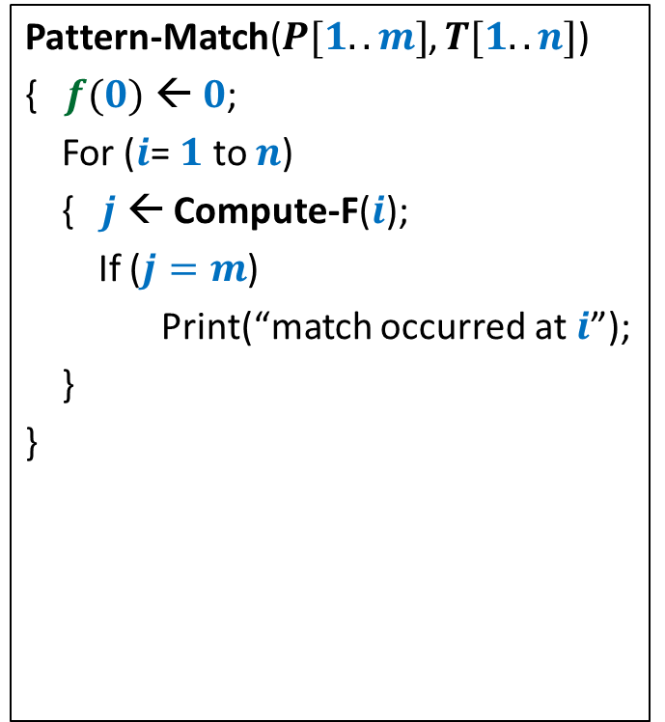
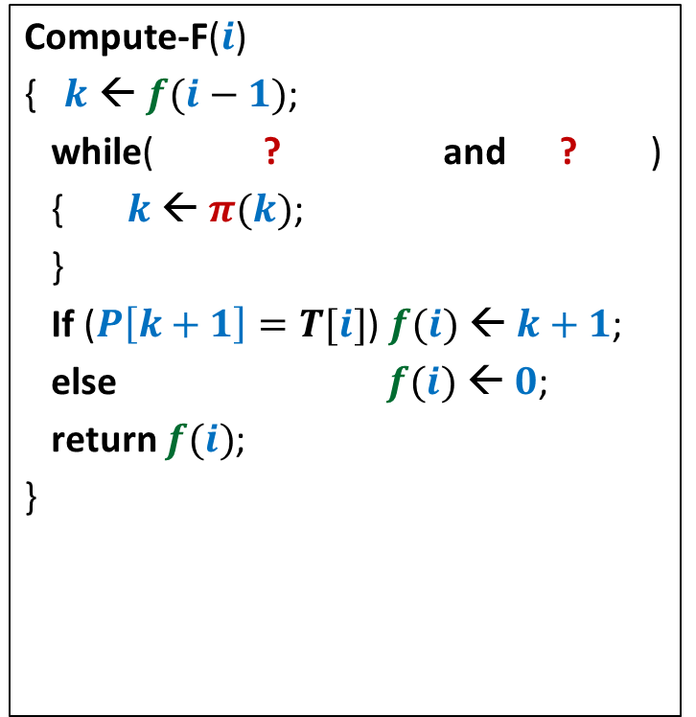


The KMP algorithm
Compute-F($i$)
{ $k$ ← $f(i−1)$;
while( ? and ? )
{ $k$ ← $π(k)$;
}
If ($P\left[k+1\right]=T[i]$) $f(i)$ ← $k+1$;
else $f(i)$ ← $0$;
return $f(i)$;
}
Pattern-Match($P[1..m]$, $T[1..n]$)
{ $f(0)$ ← $0$;
For ($i$= $1$ to $n$)
{ $j$ ← Compute-F($i$);
If ($j=m$)
Print(“match occurred at $i$”);
}
}
$$P\left[k+1\right]≠T[i]$$
$$k>0$$

Slide 17
Analysis of the running time

Slide 18

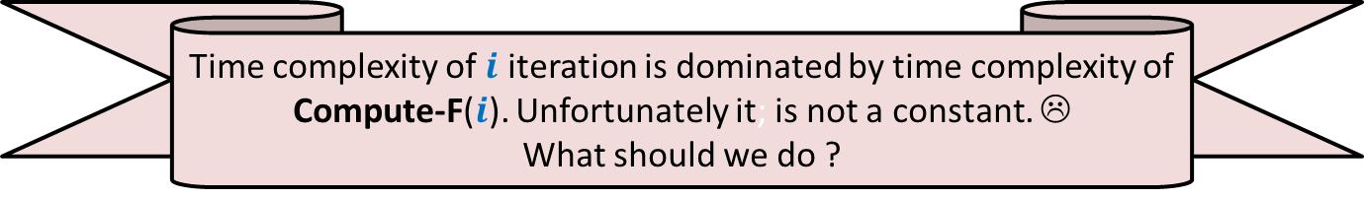




Analysis
Compute-F($i$)
{ $k$ ← $f(i−1)$;
while( ? and ? )
{ $k$ ← $π(k)$;
}
If ($P\left[k+1\right]=T[i]$) $f(i)$ ← $k+1$;
else $f(i)$ ← $0$;
return $f(i)$;
}
Pattern-Match($P[1..m]$, $T[1..n]$)
{ $f(0)$ ← $0$;
For ($i$= $1$ to $n$)
{ $j$ ← Compute-F($i$);
If ($j=m$)
Print(“match occurred at $i$”);
}
}
$$P\left[k+1\right]≠T[i]$$
$$k>0$$
Time complexity of $i$ iteration is dominated by time complexity of Compute-F($i$). Unfortunately it; is not a constant. ☹
What should we do ?
Let us try to show that amortized time complexity of $i$ iteration is dominated by O($1$). ☺

Slide 19










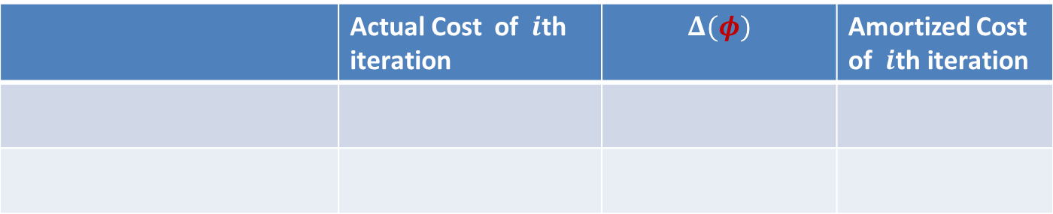

Analysis
Compute-F($i$)
{ $k$ ← $f(i−1)$;
while( ? and ? )
{ $k$ ← $π(k)$;
}
If ($P\left[k+1\right]=T[i]$) $f(i)$ ← $k+1$;
else $f(i)$ ← $0$;
return $f(i)$;
}
Pattern-Match($P[1..m]$, $T[1..n]$)
{ $f(0)$ ← $0$;
For ($i$= $1$ to $n$)
{ $j$ ← Compute-F($i$);
If ($j=m$)
Print(“match occurred at $i$”);
}
}
$$P\left[k+1\right]≠T[i]$$
$$k>0$$
 | Actual Cost of $i$th iteration | $$Δ(φ)$$ | Amortized Cost of $i$th iteration
Case 1: $f\left(i\right)=f\left(i−1\right)+1$
$$c$$
$$c$$
$$2c$$
Case 2: $f\left(i\right)<f\left(i−1\right)$
$$≤c(f\left(i−1\right)−f\left(i\right))$$
$$c(f\left(i\right)−f\left(i−1\right))$$
$$≤0$$
Yes, $f$ has decreased.
So try it as a $φ$.
What should be $φ$ ?
Is there anything that has decreased ?
Look carefully at the Case 2.
$φ$ at end of $i$th iteration = $cf\left(i\right)$

Slide 20
Analysis
Compute-F($i$)
{ $k$ ← $f(i−1)$;
while( ? and ? )
{ $k$ ← $π(k)$;
}
If ($P\left[k+1\right]=T[i]$) $f(i)$ ← $k+1$;
else $f(i)$ ← $0$;
return $f(i)$;
}
Pattern-Match($P[1..m]$, $T[1..n]$)
{ $f(0)$ ← $0$;
For ($i$= $1$ to $n$)
{ $j$ ← Compute-F($i$);
If ($j=m$)
Print(“match occurred at $i$”);
}
}
$$P\left[k+1\right]≠T[i]$$
$$k>0$$
 | Actual Cost of $i$th iteration | $$Δ(φ)$$ | Amortized Cost of $i$th iteration
Case 1: $f\left(i\right)=f\left(i−1\right)+1$
$$c$$
$$c$$
$$2c$$
Case 2: $f\left(i\right)<f\left(i−1\right)$
$$≤c(f\left(i−1\right)−f\left(i\right))$$
$$c(f\left(i\right)−f\left(i−1\right))$$
$$≤0$$
$φ$ at end of $i$th iteration = $cf\left(i\right)$

Slide 21
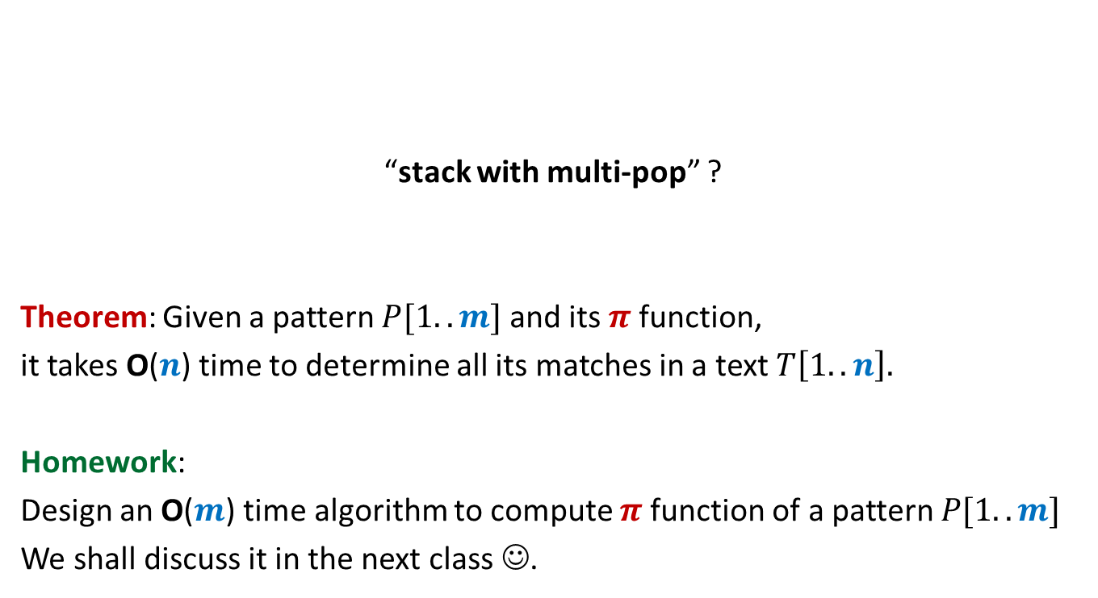
Does the analysis remind you of the analysis of some problem we did in the recent past ?
“stack with multi-pop” ?
Theorem: Given a pattern $P[1..m]$ and its $π$function,
it takes O($n$) time to determine all its matches in a text $T\left[1..n\right].$
Homework:
Design an O($m$) time algorithm to compute $π$function of a pattern $P[1..m]$
We shall discuss it in the next class ☺.

Slide 22
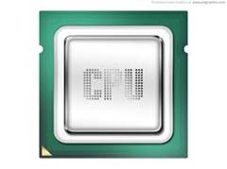
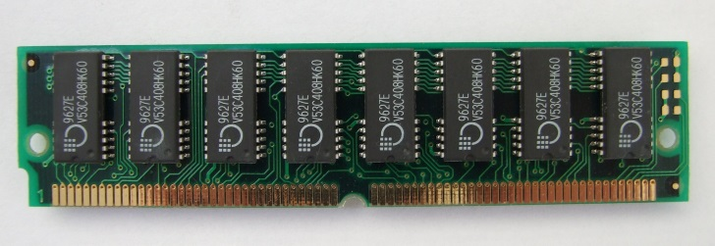
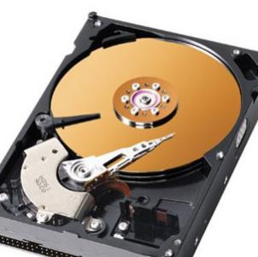
A real computer
Assumption:
Entire input resides in RAM
RAM model
of computation
Input
RAM
But when data is too large …

Slide 23
An accurate model of computer for large data
CPU time: free
Time Complexity : No. of scans to solve the problem
RAM
Disc

Slide 24
Finding Median of 5 Trillion numbers
Efficiently using a computer of 1980’s

Slide 25






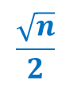

Computing median of $n$ elements
RAM size= $Θ(\sqrt{n})$
Algorithm | No. of scans
O($n$)
$$\frac{\sqrt{n}}{2}$$
Exercise level
Assignment level
O($\log{n}$)
Novel
$$2$$
Optimal
Assumptions:
(for ease of understanding)
$n$ = $2^{2k}$
for some $k$
All elements are distinct.

Slide 26
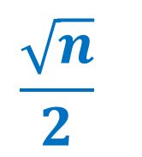
ScAns Algorithm
$$\frac{\sqrt{n}}{2}$$

Slide 27













$\frac{\sqrt{n}}{2}$ scans algorithm
RAM size= $Θ(\sqrt{n})$
Compute smallest $\sqrt{n}$ elements in one scan.
Compute next smallest $\sqrt{n}$ elements in one scan.
Compute next smallest $\sqrt{n}$ elements in one scan.
$$2 7 10 21 42$$
RAM
$$42$$
Effective input size
$$n$$
Can’t we speed it up ?
$$n−\sqrt{n}$$
$$n−2\sqrt{n}$$
$$10$$
$$42$$
$$21$$
$$2$$
$$7$$
Disc

Slide 28

$O(log n)$Scans Algorithm
Approach:
Divide and Conquer
Ponder over it. We shall discuss it in the next class.

